Slide 1

Version Control

Slide 2
What is it?
Software to help keep track of changes made to files or directories.
Tracks the history of your work.
Helps you collaborate with others.

Slide 3
With version control you can..
Keep track of changes like a lab notebook for code and documents.
Roll back changes to any point in the history of changes to our files.
Back up our entire history of changes in various locations.
Work on our files from multiple locations.
Identify and resolve conflicts when same file is edited within two repositories without losing any work.
Collaboratively work on code or documents or any other files.

Slide 4
Keeping track of history
How do you get back to that working version you had yesterday?
How do you get from “it’s not working!” to understanding what went wrong?
How would you repeat the experiments from that journal paper you wrote last year?

Slide 5
Collaborating .. with yourself!
You need to run the same software on your laptop at home and the server in the lab:
How do you get the code onto both?
How do you verify that you have same code on both?

Slide 6
Collaborating with others
You’re working on a code or a paper with a colleague..
How do you find out when they change something?
How do you merge your changes without getting in a mess?
How can you find out which of you introduced a bug, and when?
Version control helps with all this!

Slide 7
Different version control systems
Centralized: Subversion
One server, one repository database
Every commit goes straight to the shared repository.
Distributed: Git, Mercurial
Every working copy has complete repository in it.
Commits are local, the push/ pull between local and remote.

Slide 8
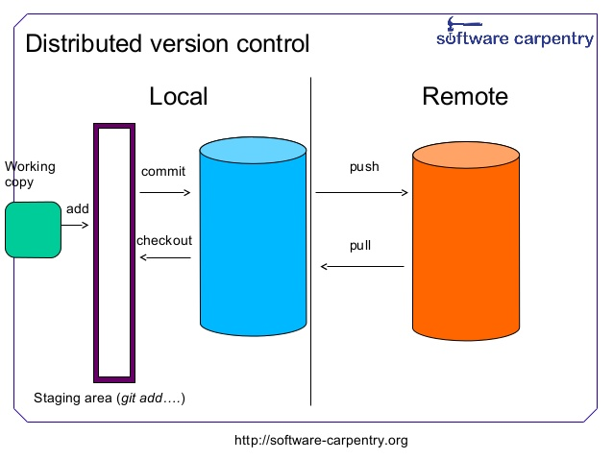
Distributed version control

Slide 9
Terminology
Repository: The complete history of your project: every version of every file.
Working copy: The project as you’re working on it now.
Add: a file you want system to track.
Commit: to record a change, making a new revision.
Update: to make your working copy reflect a different revision from the repository.
Push/ Pull: to synchronize copies of repository.

Slide 10
Time to get cracking!

Slide 11
Git file modes:
Git tracks file permissions:
0100000000000000 (040000): Directory
1000000110100100 (100644): Regular non-executable file
1000000110110100 (100664): Regular non-executable group-
writeable file
1000000111101101 (100755): Regular executable file
1010000000000000 (120000): Symbolic link
1110000000000000 (160000): Gitlink

Slide 12
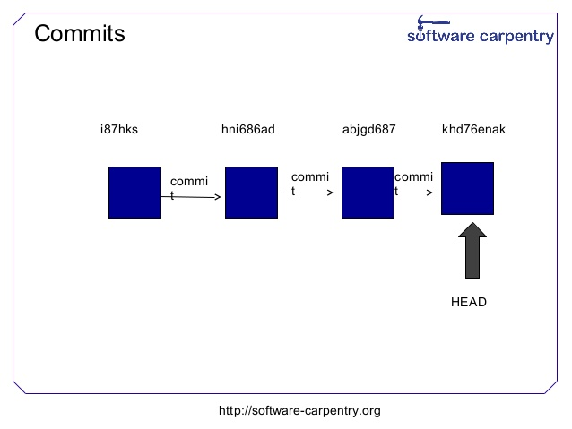

Slide 13
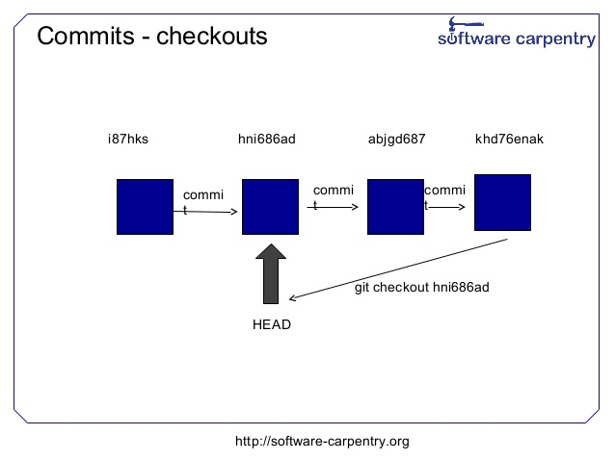

Slide 14
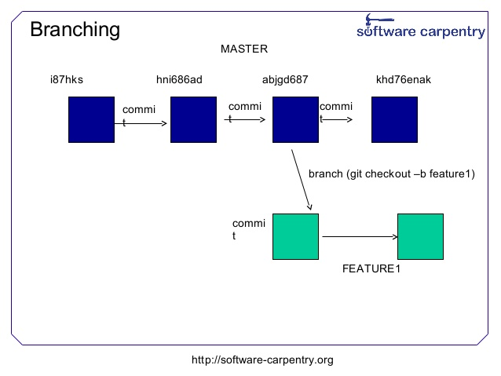

Slide 15
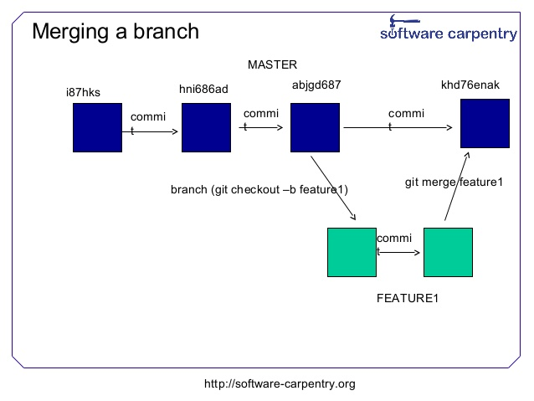

Slide 16
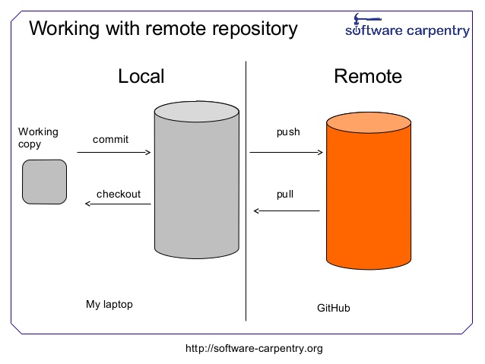

Slide 17
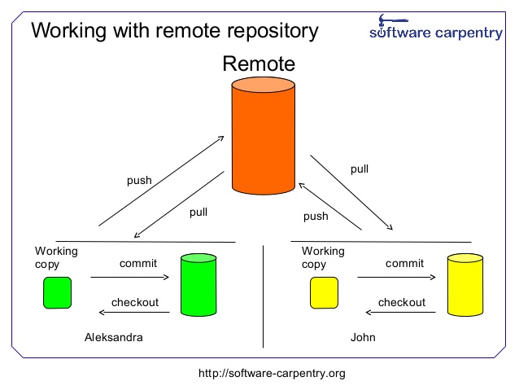

Slide 18
Any Questions?

